Slide 1
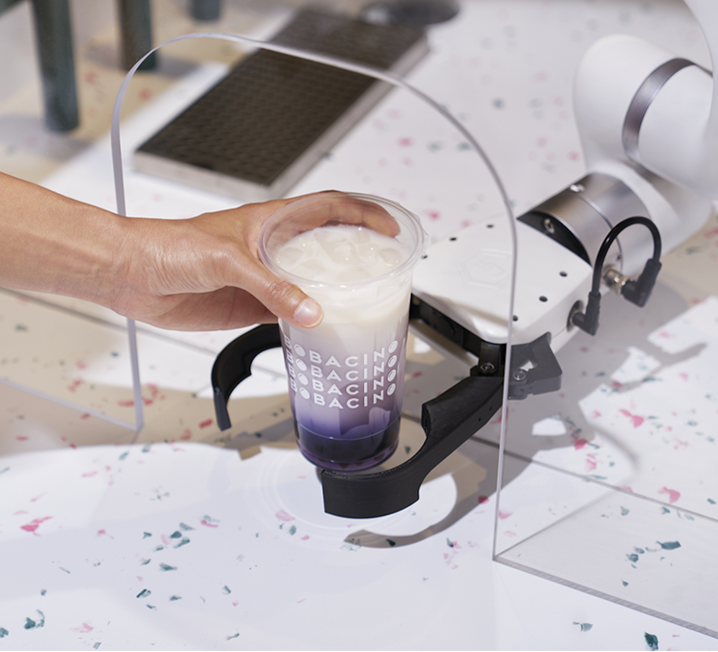

NeuroMotion
Affordable AI-Powered Robots for Perfect Bubble Tea, Every Time.

Slide 2




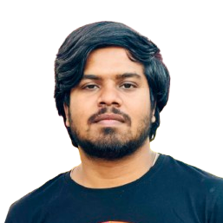
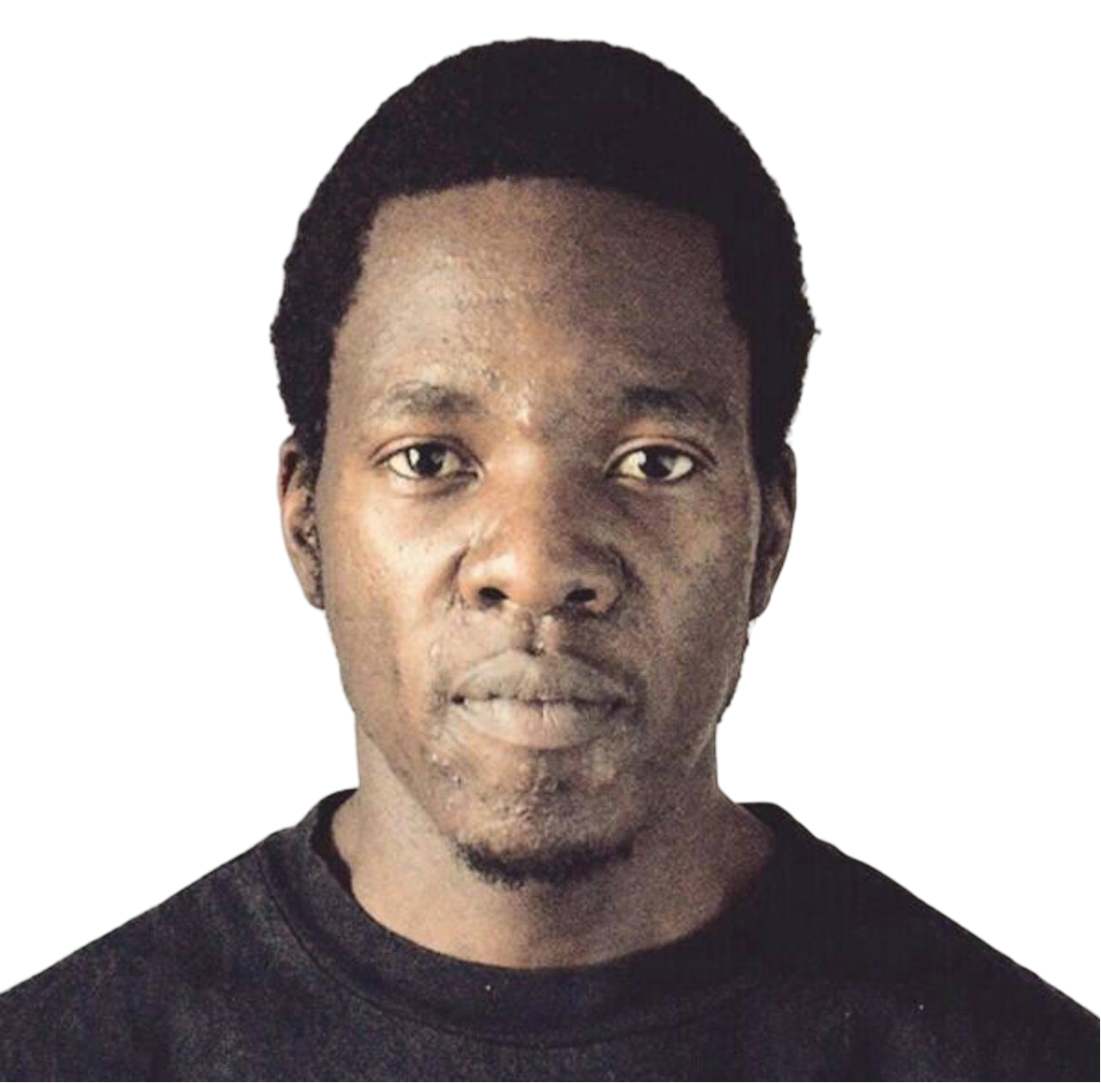
Our Team
NeuroMotion
Min Thiha Soe, MS 2025
(Organization Lead)
5+ years (F&B)
Project Manager
AI solutions developer
Automation Engineer
Pavan Kumar N, MS 2026
(Technical Lead)
3+ years of expertise
Product Design Engineer
Toyota Automotive Parts Manufacturing Engineer.
Munyaradzi Antony, ME 2025
(Business Development)
5+ years in Coca-Cola
Business & strategic planner
Manufacturing Manager
Robotics Engineer

Slide 3


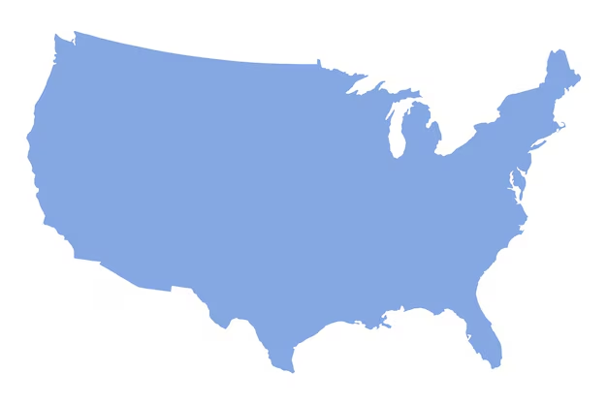

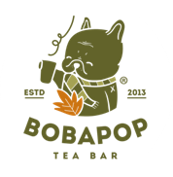
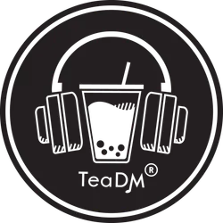

Our Customer
NeuroMotion
Global Bubble Tea Market (CAGR: 8%)
Total Addressable Market
$2.83B
Medium-Large Tea Shops in USA (6,635 businesses)
Serviceable
Addressable Market
$496.75 Mil
Tea shops with robotics or exploring automation (1400+)
Labour cost : 30% of total sales (37.5 million)
Serviceable Obtainable
Market
$125+ Mil

Slide 4
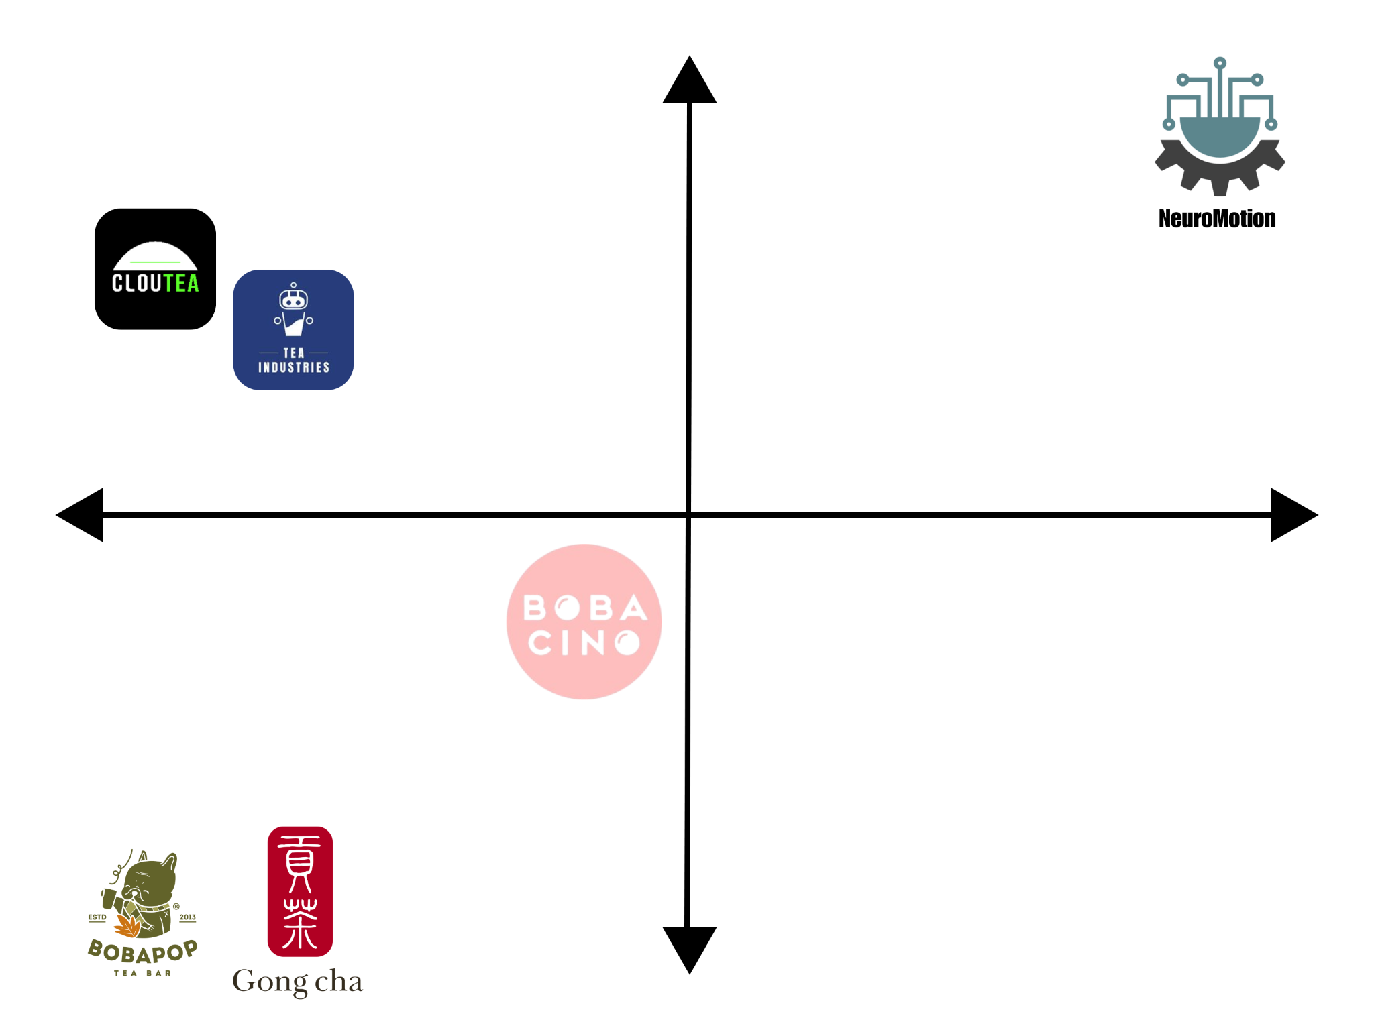
Customer Problem & Current Alternative
High
Delivery speed
Consistency
Repeatability
Problems:
Labour shortage
Inconsistent order
Slow delivery speed
Opportunity:
Robot-Barista collaboration
AI Integration
Our competitors
Traditional Expensive controls / Baristas
Less Expensive AI Integrated controls
Low
Current Bubble Tea Businesses without Robots
Notes:
Customer Problems: Labour Shortage, inconsistent flavour, cheap robotic system are often unreliable.
Less expensive and more intelligent
Labour shortage
Inconsistent order (Uneven mixing/wrong order)
Low delivery speed in peak hours.
Consistency in flavor, texture, and presentation is critical for bubble tea shops. Consistency Keeps Customers Coming Back.
Current competitors: uses expensive solution for precision controls or they may

Slide 5
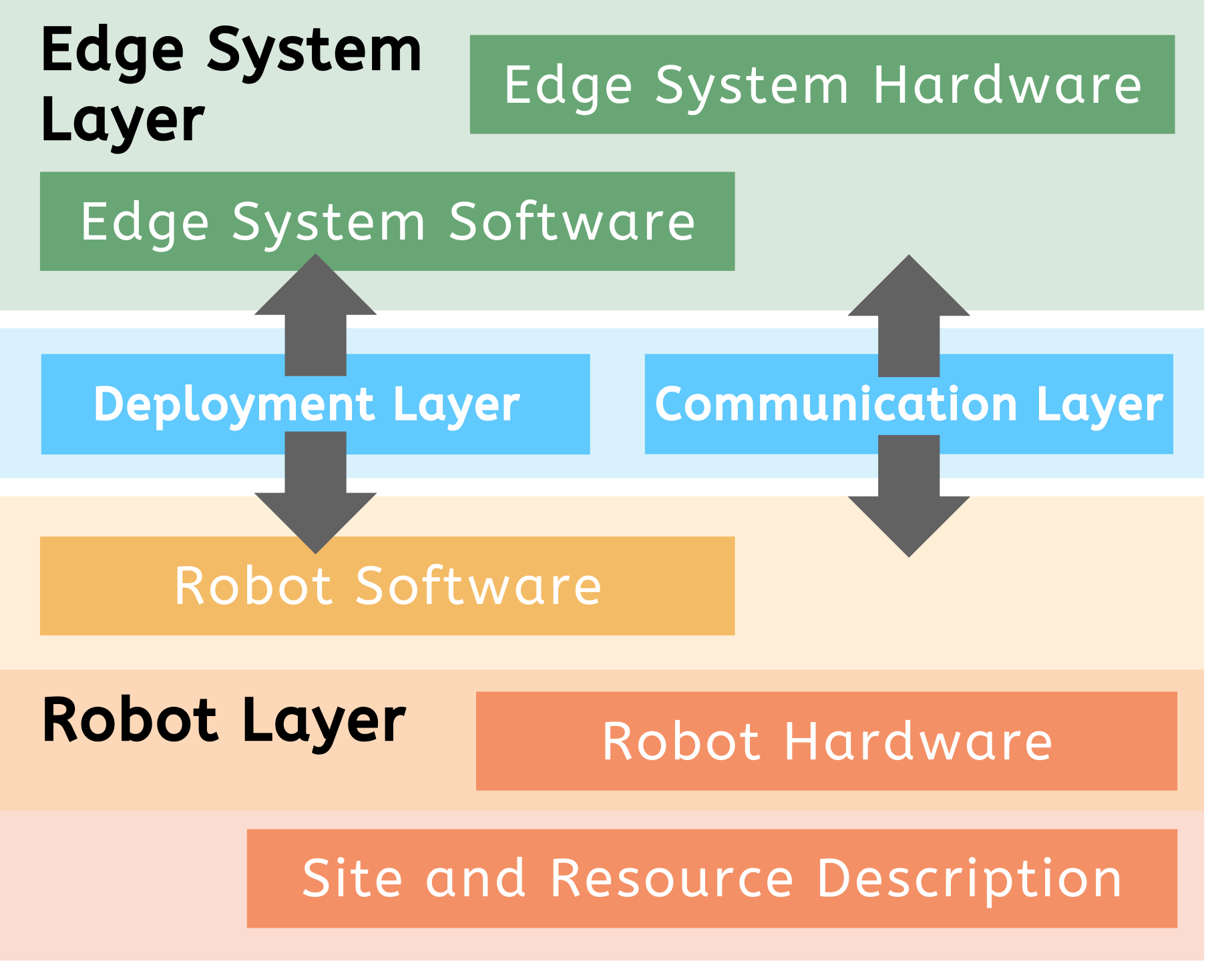
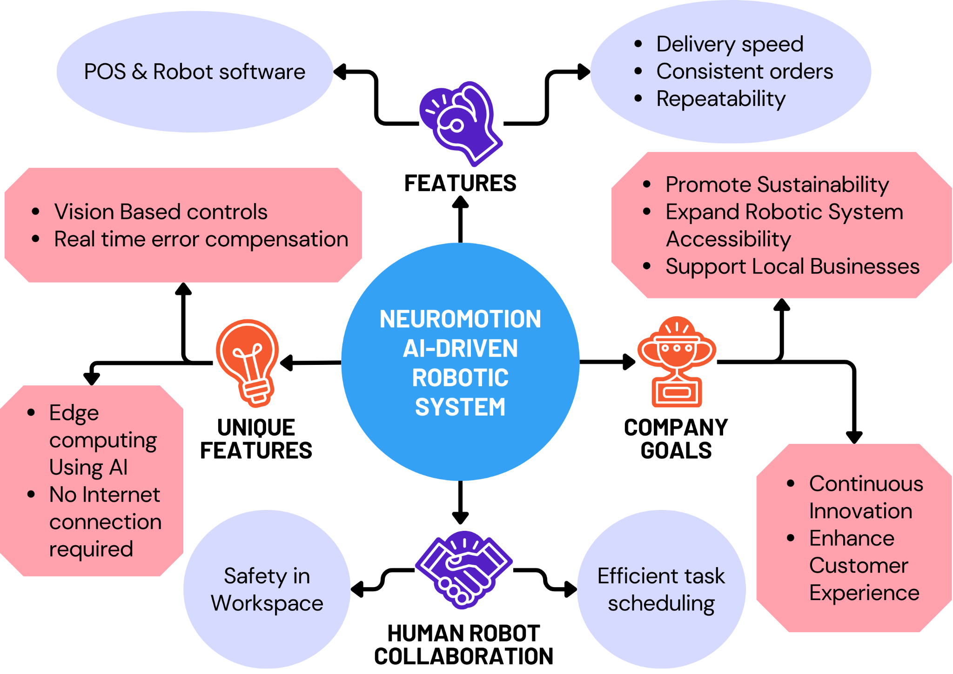
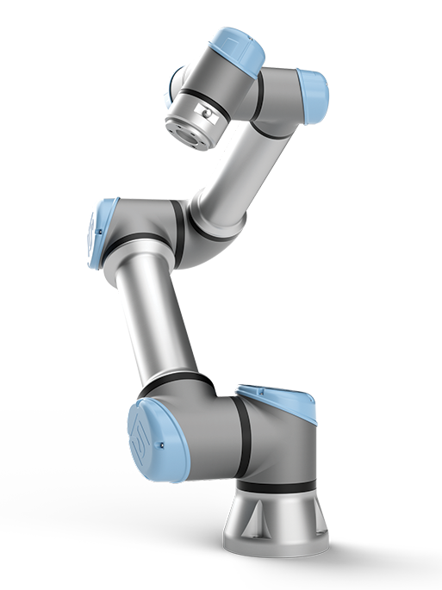
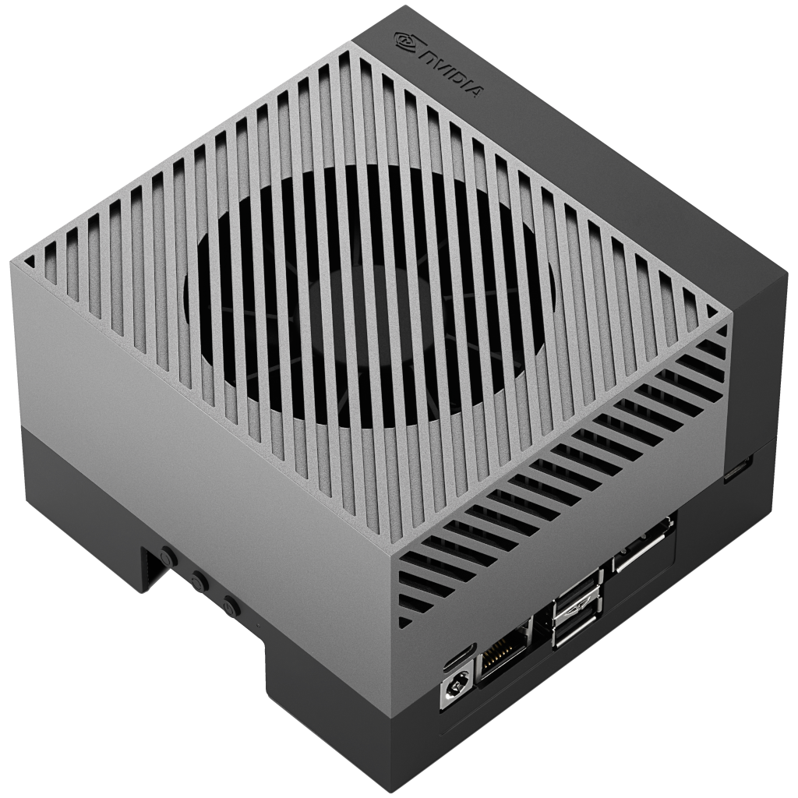
Solution & Value Proposition
NeuroMotion
Edge System Hardware
Robot Hardware

Slide 6




Business & Financing Model
NeuroMotion
One-time fee: $30,000/robot (includes accessories & installation) | Subscription Plan: $2000/month.
Customer Acquisition Cost (CAC):
Year 1: $25,000
Year 2: $19,333
Year 3: $11,500
Attributes
Year 1
Year 2
Year 3
Number of customers
Revenue
Cost of good sold
Gross Profit/Loss
Business Cost
Net Profit/Loss
20 Shops
$ 1,080,000
$ 650,000
$ 430,000
$ 500,000
($70,000)
50 Shops
$ 2,100,000
$ 1,000,000
$ 1,100,000
$ 1,080,000
($20,000)
130 Shops
$ 5,520,000
$ 2,900,000
$ 2,620,000
$ 2,000,000
+$ 620,000
Churn Rate: 5%
Customer Lifetime Value (LTV) = $14,333
Startup
Growth
Profit
Development Phase
Engagement Zone

Slide 7


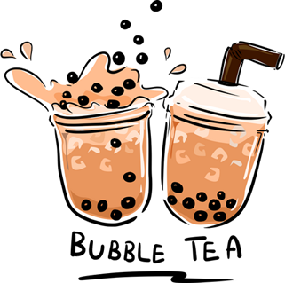
Summary
NeuroMotion is revolutionizing:
Robotic automation with AI
Optimizing efficiency
Order Consistency & Safety
Scalability in F&B and beyond.
NeuroMotion
Use of NVC Prize Money:
Funding: $80,000
40% Product Development
40% Marketing/Sales
20% Operation/Inventory
0% Existing Debt
Contact Us:
minthiha.soe@gwu.edu
pavankumar.nagaraju@gwu.edu
mantony2@umd.edu

